Slide 1

Automotive Technology:
A Systems Approach, 8e
Chapter 13: Engine Sealing and Reassembly
Rob Thompson and Jack Erjavec, Automotive Technology: A Systems Approach, 8th Edition. © 2025 Cengage. All Rights Reserved. May not be scanned, copied or duplicated, or posted to a publicly accessible website, in whole or in part.

Slide 2
Chapter Objectives (1 of 2)
13.01 Explain torque as applied to fasteners.
13.02 Explain the purpose of the various gaskets used in an engine.
13.03 Identify the major gasket types and their uses.
13.04 Explain general gasket installation procedures.
13.05 Describe types of adhesives and sealants used in engine repair.

Slide 3
Chapter Objectives (2 of 2)
13.06 Explain the construction and types of engine oil seals.
13.07 Reassemble an engine including core plugs, bearings, crankshaft, camshaft, pistons, connecting rods, timing components, cylinder head, valve train components, oil pump, oil pan, and timing covers.
13.08 Reinstall an engine and perform the correct starting and break-in procedures.

Slide 4
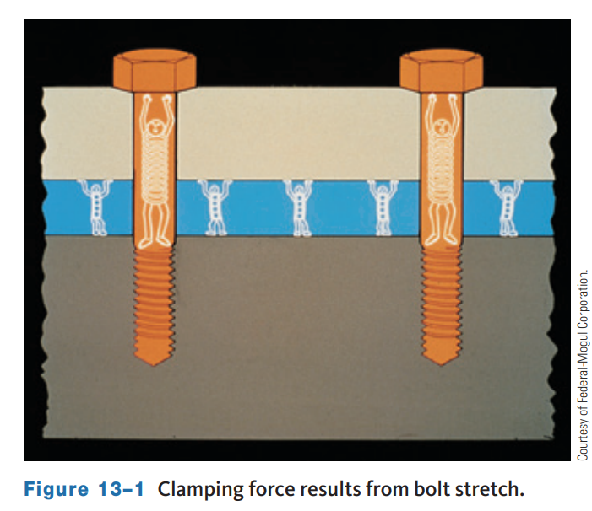
Torque Principles (1 of 3)
All metals are elastic. Elasticity means a bolt can be stretched and compressed up to a certain point.
This elastic, spring-like property is what provides the clamping force when a bolt is threaded into a tapped bore or when a nut is tightened.
As the bolt is tightened, it is stretched a few thousandths of an inch. Clamping force or holding power is created due to the bolt’s natural tendency to return to its original length.
The more a bolt is stretched, the tighter it becomes. However, a bolt can be stretched too far. This is obvious when the grip on the wrench feels “mushy.” At this point, the bolt can no longer safely carry the load it was designed to support.
The term yield represents the maximum amount of stretch a bolt can experience and still provide clamping pressure. If a bolt is stretched into yield, it takes a permanent set and never returns to normal.

Slide 5
Torque Principles (2 of 3)
Visually inspect the bolts.
  Threads must be clean and undamaged. Discard all bolts that are not acceptable.
  Run a nut over the bolt’s threads by hand. Discard the bolt if any binding occurs.
  Clean bolt and internal threads with a thread chaser or tap.
Apply a light coat of 10W engine oil to the threads and bottom face of the bolt head. A sealer is required for a bolt that enters a water jacket. This will stop seepage around the bolt threads. Seeping coolant could get in the oil or cause corrosion that might damage parts, resulting in engine failure.
Tighten bolts with an accurate torque wrench in the recommended sequence. This is important to prevent warpage of the parts.
If bolt heads are not tight against the surface, the bolts should be removed and washers installed.
Make sure the bolt is the proper length. Internal threads often pull up, leaving a raised edge around the bore. If a part has been resurfaced, the threads might run up to the surface. The bolt bores should be tapered at the surface by chamfering and the threads.

Slide 6
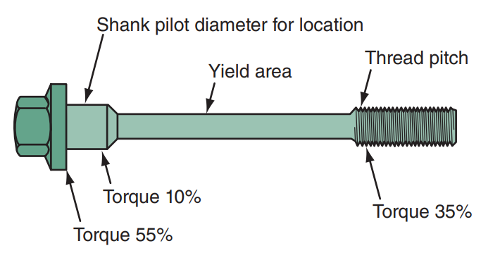
Torque Principles (3 of 3)
Torque-to-Yield (TTY) Bolts
  They are designed to stretch when properly tightened.
  They are not ordinary bolts.
  The bolt shank is designed to stretch and spring back up to its yield point when tightened.
  Once at the yield point, the bolt becomes permanently stretched and will not return to its original length.

Slide 7
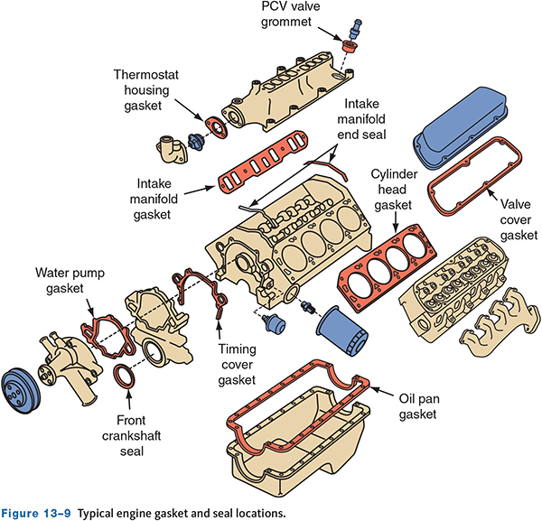
Gaskets (1 of 4)
13.03 Identify the major gasket types and their uses.
Gaskets provide a seal between parts and also serve as spacers, wear insulators, and vibration dampers.
Gaskets are only used between two stationary parts.
Seals are used if one of the parts moves.
The material used to make a gasket depends on its application.

Slide 8
Gaskets (2 of 4)
Cut Gaskets
  They are gaskets made of paper, fiber, and cork.
Molded Rubber Gaskets
  These gaskets are made by injecting synthetic rubber (neoprene, nitrile, silicone, or other similar material) into a mold to form one-piece gaskets. Molded gaskets retain their flexibility and are durable.
Hard Gaskets
  Hard gaskets are made from steel, stainless steel, copper, or a combination of metals and other materials. Often the metal is enclosed by a compressible and heat-resistant clay/fiber or Teflon® compound.

Slide 9
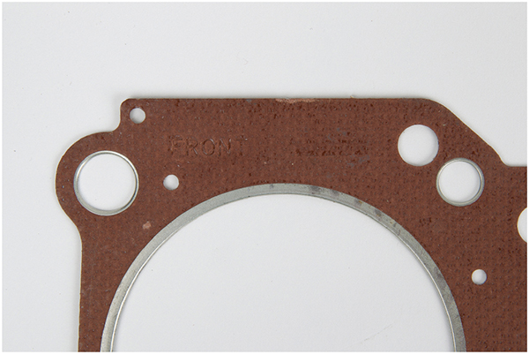
Gaskets (3 of 4)
13.04 Explain general gasket installation procedures.
The following instructions will serve as a helpful guide for installing gaskets.
Because there are many different gasket materials and designs, it is impossible to list directions for every type of installation.
Always follow any special directions provided in the instructions packed with the gasket sets.

Slide 10
Gaskets (4 of 4)
Never reuse old gaskets.
Make sure you are installing the latest gasket part number. Sometimes, gasket designs are revised and improved to correct pattern failures.
Handle new gaskets carefully.
Cleanliness is essential. New gaskets seal best when used on clean surfaces.
Use the right gasket in the right position. Always compare the new gasket to the mating surfaces to make sure it is the right gasket. Check that all bolt holes, dowel holes, coolant, and lubrication passages line up perfectly with the gasket. Some gaskets have directions such as “top,” “front,” or “this side up” stamped on one surface. Use sealants and adhesives only when the engine or gasket manufacturer recommends their use. Some chemicals will react negatively with the gasket’s coating.
Always start each bolt into its hole before you begin to tighten any of the bolts. Tightening bolts before all bolts are installed will cause component misalignment and prevent some bolts from threading into their holes.

Slide 11
Head Gaskets (1 of 3)
Cylinder head gaskets seal the cylinder head to the block.
  The head gasket has a very demanding job. It must seal the combustion chambers and the coolant and oil passages between the head and the block. The oil and coolant are low-temperature and low-pressure fluids. The gasket must prevent leakage inside and outside the engine. It must be able to do this while sustaining wide temperature ranges and pressures inside each cylinder.
Cylinder head gaskets must simultaneously do the following:
  Seal intake stroke vacuum, combustion pressure, and the heat of combustion.
  Prevent coolant leakage and resist rust, corrosion, and, in many cases, meter coolant flow.
  Seal oil passages through the block and head while resisting chemical action.
  Allow for lateral and vertical head movement as the engine heats and cools.
  Be flexible enough to seal minor surface warpage while being stiff enough to maintain adequate gasket compression.
  Fill small machining marks that could lead to serious gasket leakage and failure.

Slide 12
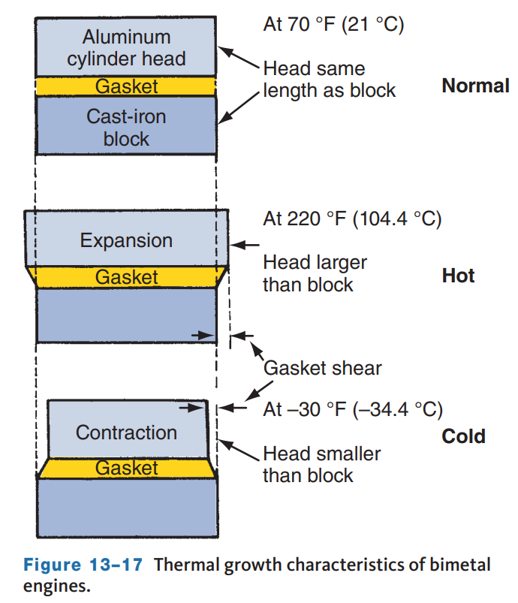
Head Gaskets (2 of 3)
Head gaskets for many late-model cast-iron engines have raised silicone, Viton, or fluoroelastomer sealing beads on their face to increase the clamping pressure around some areas.
Most head gaskets have a steel fire ring that surrounds the top of the cylinder. These protect the gasket material used elsewhere. The durability of a head gasket can also be improved by using strong, high-temperature fibers such as aramid and Kevlar and by adding reinforcements around oil passages.
Most late-model engines have aluminum cylinder heads and cast-iron blocks. When heated, aluminum expands two to three times more than steel. This creates a back-and-forth scrubbing action on a head gasket as the engine temperature changes. This movement can tear a gasket apart if it is not designed to handle it.

Slide 13
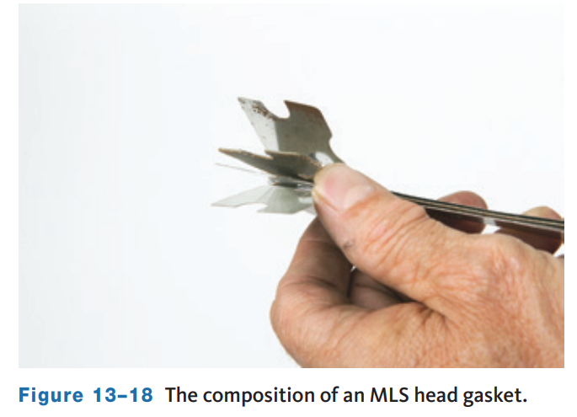
Head Gaskets (3 of 3)
To reduce the chances of a gasket tearing, graphite or specially coated gaskets are used. Graphite is a relatively soft material that can withstand high temperatures, and it is a natural lubricant. Teflon®, molybdenum, and other similar slippery nonstick coatings are used on other gasket designs to prevent the gasket from sticking to either surface.
Many engines have multilayer steel (MLS) head gaskets.
These gaskets comprise three to seven layers of steel. The outer layers are embossed stainless spring steel coated with a thin layer of an antifriction coating of Teflon®, nitrile rubber, or Viton.

Slide 14
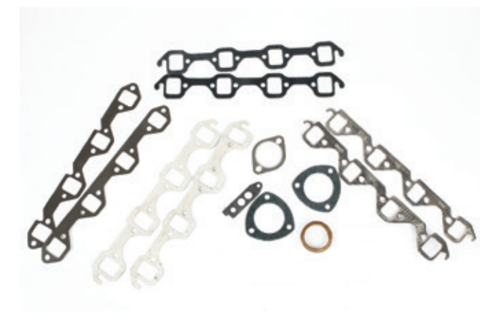
Specific Engine Gaskets (1 of 3)
There are three basic types of manifold gaskets:
  intake manifold
  exhaust manifold
  intake and exhaust combination
Combination gaskets are often used on inline engines without cross-flow heads.
Manifold gaskets are made of a variety of materials, depending on the application.
Each type of manifold gasket has its own sealing characteristics and problems.
Therefore, be sure to follow the manufacturer’s instructions when installing them.
Before installing a manifold and its gasket, make sure that the mating surfaces on the head and manifold are flat and free of damage.

Slide 15
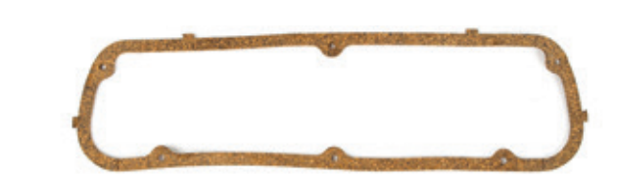
Specific Engine Gaskets (2 of 3)
Valve cover gaskets must make a seal between a steel, aluminum, magnesium, or molded plastic cover and the cylinder head surface.
On OHC engines, cam covers are normally made of diecast aluminum.
Some cylinder cover gaskets have spark plug gaskets integrated into the gasket.
When installing these, make sure the gasket is perfectly aligned. Valve cover bolts are usually widely spaced so the gasket material is able to seal without being tightly clamped.
Valve cover gaskets must be able to withstand high temperatures and the caustic action of acids in the oil.

Slide 16
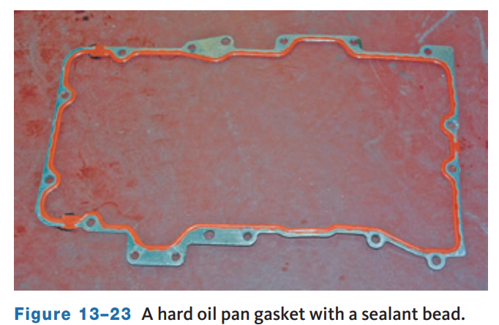
Specific Engine Gaskets (3 of 3)
An oil pan gasket seals the joint between the oil pan and the bottom of the block and might also seal the bottom of the timing cover and the lower section of the rear main bearing cap.
Like valve cover gaskets, the oil pan gasket must resist hot, thin engine oil.
Because of the added weight and splash of crankcase oil, the pan has many retaining bolts closely spaced resulting in clamping force on the oil pan gasket is great.
Oil pan gaskets may be made with several types of material. A commonly used material is synthetic rubber, known for its long-term sealing ability.
Many late-model engines use a hard gasket with a bead of sealant around the inside dimensions of the gasket which increases clamping pressures and provides a positive seal.

Slide 17
Discussion
There are various types of gaskets used to seal an engine.
Have a class discussion about some of the gasket types and the procedures explained when servicing these different gaskets.

Slide 18
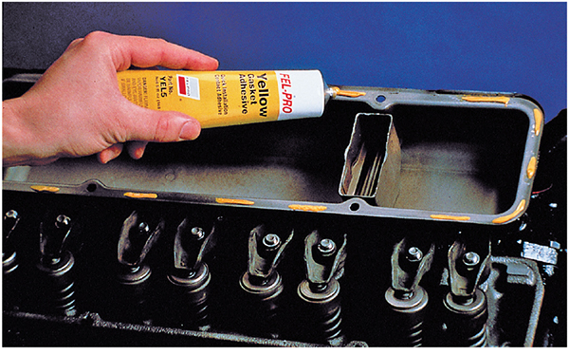
Adhesives, Sealants, and Other Sealing Materials (1 of 2)
13.05 Describe types of adhesives and sealants used in engine repair.
Adhesives
  Gasket adhesives form a tough bond when used on clean, dry surfaces.
  Adhesives do not aid the sealing ability of the gasket.
  They are meant only to hold gaskets in place during assembly.
  Do not assemble components until the adhesive is dry.

Slide 19
Adhesives, Sealants, and Other Sealing Materials (2 of 2)
Manufacturers sometimes specify the use of sealants to assist a gasket or seal or to form a new gasket. The sealants should only be used when specified by the manufacturer.
General-purpose sealers are liquid and available in a brush type (known as brush tack) or an aerosol type (known as spray tack). General-purpose sealers form a tacky, flexible seal when applied in a thin, even coat that aids in gasket sealing by helping to position the gasket during assembly.
Bolts that pass through a liquid passage should be coated with Teflon® thread or a brush-on thread sealant. Some head bolts or water pump bolts tighten into a coolant passage and must be sealed or they will leak. These flexible sealants are nonhardening sealers that fill voids, preventing the fluid from running up the threads.
Silicone (or formed-in-place FIP) gaskets are a liquid sealant applied directly to mating surfaces and are allowed to cure in place. Many technicians use silicone gasketing to aid the sealing of corners, notches, or dovetails of gaskets.

Slide 20
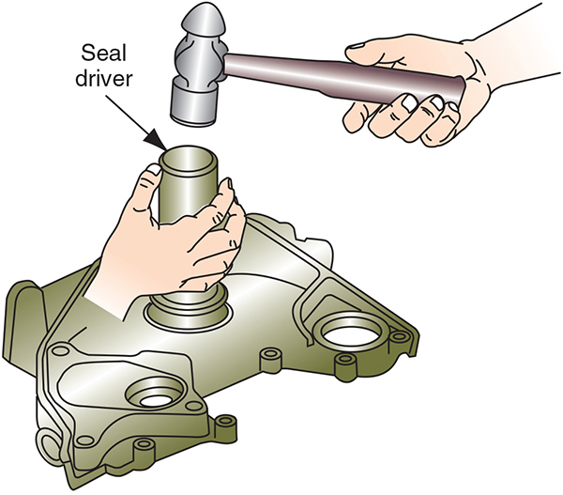
Oil Seals (1 of 2)
13.06 Explain the construction and types of engine oil seals.
Seals keep oil and other fluids from escaping around a rotating shaft.
Timing Cover Oil Seals
  The timing cover seal prevents oil from leaking around the crankshaft.
  Its installation often requires the use of a special tool or a driver.
  It is important that the seal is positioned squarely in the bore of the cover, and the crankshaft is positioned in the center of the seal.

Slide 21
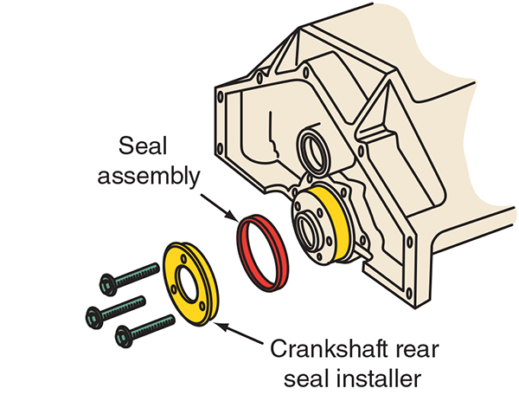
Oil Seals (2 of 2)
Rear main bearing seals keep oil from leaking around the rear main bearing.
Four types of synthetic rubber are used for rear main bearing seals:
  Polyacrylate may be used because it is tough and abrasion resistant, with moderate temperature resistance.
  Silicone synthetic rubber has a greater temperature range, but it has less resistance to abrasion and is more fragile than polyacrylate. They must be carefully handled.
  Viton has the abrasion resistance of polyacrylate and the temperature range of silicone, but it is more expensive.
  Synthetic rubber seals may be one piece or two pieces. PTFE rubber oil seals now in use have reduced friction, a wider temperature operating range, and better chemical resistance than Viton and polyacrylate seals.

Slide 22
Knowledge Check (1 of 2)
  Seals keep oil and other fluids from escaping around a ______ ______.

Slide 23
Knowledge Check Answer (1 of 2)
  Answer: Seals keep oil and other fluids from escaping around a rotating shaft.

Slide 24
Engine Reassembly (1 of 5)
13.07 Reassemble an engine including core plugs, bearings, crankshaft, camshaft, pistons, connecting rods, timing components, cylinder head, valve train components, oil pump, oil pan, and timing covers.
When reassembling an engine, the sequence is essentially the reverse of the teardown sequence given in a previous chapter.
Many engines use head bolts of different lengths, and their location is given in the service information; clean and lightly lubricate with engine oil.
Position the head gasket on the block and make sure it matches the bores in the block. Place the cylinder head onto the block.
Make sure that the dowel pins are in place and that the head and block are properly aligned. Tighten the head bolts according to the recommended sequence and to the specified torque.
For OHV engines, before inserting the pushrods, check their straightness by rolling them on a flat, level surface. Inspect the ends for wear and make sure the internal passage is clear. When installing, apply some assembly lube to both ends.

Slide 25
Engine Reassembly (2 of 5)
Liberally coat the rocker arms with assembly lube or clean engine oil. Then install the pushrods and rocker arms. Many OHV engines have positive stop rocker arm adjustments.
This means that when torquing the rocker arms to spec, the plunger of the hydraulic lifter is properly positioned, giving the correct lifter adjustment.
The alignment of the camshaft(s) with the crankshaft is critical. The alignment marks and the correct procedure for doing this vary with the engine design.
Many engines have primary (cam) belts and secondary belts for the balance shafts. These must be properly timed.
Check the service information for the correct alignment and tension adjustment procedures. Make sure that the belt tensioners are set properly.
Replacement of the belts and related components as part of a maintenance program can decrease the chances of the belt breaking, which can cause major engine damage on interference engines.

Slide 26
Engine Reassembly (3 of 5)
Both timing belt and timing chain engines can be interference engines, meaning that if the cam and crank get out of time, the valves can be down when the pistons are moving up. This usually results in, at minimum, bent valves. In the worst situations, valve heads snap off and become embedded into the tops of the pistons.
Some engines drive the water pump with the timing belt, so replacing the pump with the belt is a common procedure.
Inspect the cam and crank oil seals for leakage while the covers are off. Replace a leaking seal while the belt is off to prevent having to go back and do the work a second time.
Now rotate the engine through at least two more revolutions. Recheck the timing marks on the crankshaft and camshaft. If necessary, readjust the timing and tension.
An engine may have a single chain, as most OHV V8 engines, or have three or more chains. DOHC engines may have individual chains that connect to each of the camshafts.
Engines with multiple chains often have multi-step timing procedures, which must be followed exactly to ensure correct timing and prevent engine damage.

Slide 27
Engine Reassembly (4 of 5)
These are general procedures to replace timing chain on a late-model V6 with the engine still in the vehicle. Always follow the manufacturer’s service information.
Remove the upper intake manifold and valve covers to access the camshafts.
Remove the crankshaft pulley and timing cover.
Set the crankshaft to the first alignment position. Remove the chain tensioner, guides, and chain for the first bank.
Rotate the crank to the second alignment position. Remove the tensioner, guides, and primary timing chain. Remove the tensioners, guides, and chain for the second bank.
When replacing the camshaft sprockets or VVT phasers.
Install the new chain on the second bank. Note any painted links on the chain. Align the chain per the service information. Install and torque the guides and tensioner. Recheck all timing marks and release the tensioner.
Install the primary chain with the timing marks aligned properly. Install the chain guides and tensioner. Recheck all timing marks and release the tensioner.
Repeat step 8 for secondary chain.

Slide 28
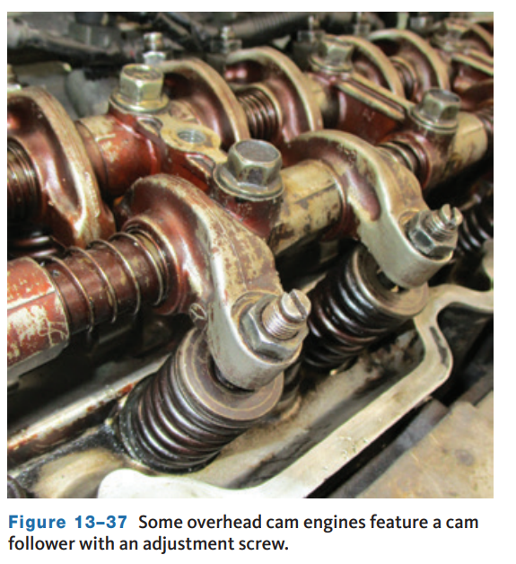
Engine Reassembly (5 of 5)
Nearly all engines must have their valve clearance set before starting after a rebuild.
Engines with solid lifters require periodic valve adjustments.
Valve clearance is called valve lash and is checked by inserting a feeler gauge between the valve tip and the rocker arm or cam lobe.
The proper amount of valve lash allows for the expansion of parts as the engine’s temperature rises.
This prevents excessive wear and/or damage to the valve train. It also minimizes valve train noise.
Always refer to the service information before adjusting valve lash.
Valve lash can be adjusted with the engine in or out of the vehicle.
The adjustment may use a threaded adjuster and lock nut, may use shims, or may utilize hydraulic lifters.

Slide 29
Final Reassembly Steps (1 of 5)
The final steps in engine reassembly involve installing various covers, pulleys, sensors, and other related items that mount directly to the engine.
Make sure all coolant drains and plugs are installed in the block. Drains are normally threaded into the block with a thread sealant. This is also true for all threaded plugs
Proper installation of the crankshaft and camshaft timing sensors is critical. Make sure to coat new O-rings with clean oil before they are installed. Some sensors have a specified gap that must be set during installation.
When replacing the timing cover, install the new seals with a press, seal driver, or hammer and a clean block of wood. When installing seals, be sure to support the underside of the cover to prevent damage.
Install the vibration damper onto the snout of the crankshaft using the proper tool. Make sure the woodruff key is in place. Some dampers are not pressed-fit onto the crankshaft.
Mount the crankshaft pulley to the outside of the damper and tighten its mounting bolts to specifications commonly using a holding tool.

Slide 30
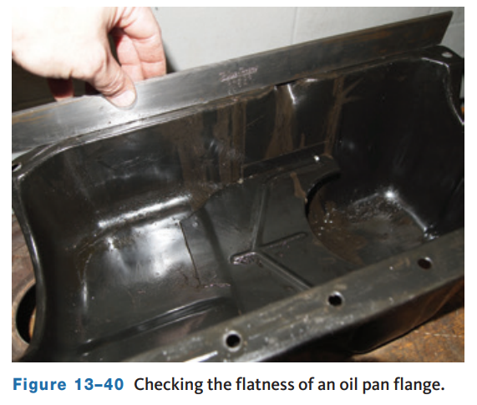
Final Reassembly Steps (2 of 5)
Cover: Before installing a stamped valve cover, make sure the cover’s sealing flange is flat, then apply contact adhesive to the valve cover’s sealing surfaces in small dabs. Mount the valve cover gasket on the valve cover and align it.
  Allow the adhesive to dry completely before mounting the valve cover on the cylinder head. Torque the mounting bolts to specifications. Cast plastic and aluminum cam and valve covers normally have a rubber gasket.
  Do not apply an adhesive or sealant to the gasket unless instructed to do so. Start all of the mounting bolts before beginning the tightening sequence.

Slide 31
Final Reassembly Steps (3 of 5)
When replacing the water pump, in many cases, a coating of waterproof sealer should be applied to both sides of the new gasket. Position the pump against the block. Install the mounting bolts and tighten them to specifications. Careless tightening could cause the pump housing to crack. After tightening, check the pump to make sure it rotates freely. Then, install the drive pulley onto the pump’s shaft.
Before installing a stamped oil pan, check the flanges for warpage. Use a straightedge (Figure 13–40) or lay the pan, flange side down, on a flat surface with a flashlight underneath it to spot uneven edges. Carefully check the flange around the bolt holes.
  Minor distortions can be corrected with a hammer and block of wood. If the flanges are too bent to be repaired in this manner, the pan should be replaced. Once it has been determined that the flanges are flat, install the oil pan with a new gasket. Cast pans are replaced if they are warped or damaged.
  Their mounting bolts should be tightened in the proper sequence and to the specified torque.

Slide 32
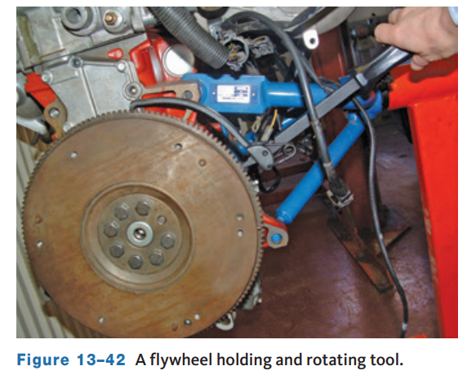
Final Reassembly Steps (4 of 5)
Set the assembled engine on the floor and support it on blocks of wood while attaching the flywheel or flexplate.
Manufacturers often recommend coating the bolts with an adhesive. A flywheel holding tool is often required to tighten the bolts to specifications.
Always follow the specified sequence while tightening.
Clutch Parts: If the vehicle has a manual transmission, install the clutch assembly.
Make sure that the transmission’s pilot bushing or bearing is in place in the rear of the crankshaft and that it is in good condition.
Using a clutch-aligning tool, or an old transmission input shaft, align the clutch disc. Then, tighten the disc and clutch pressure plate to the flywheel.

Slide 33
Final Reassembly Steps (5 of 5)
Torque Converter: On cars equipped with automatic transmissions, replace the transmission’s front pump seal before attaching it to the engine.
Install the torque converter, making sure that it is correctly engaged with the transmission’s front pump.
The drive lugs on the converter should be felt engaging the transmission front pump gear. Failure to correctly install the converter can result in damage to the transmission’s front pump.
Motor Mounts: Check the condition of all motor mounts and replace any that are damaged. Loosely attach the mounts to their location on the engine. This allows for easy alignment of the mounts while installing the engine into the vehicle. After the engine is aligned in the vehicle, the bolts should be tightened to specifications.
Other Parts: There are many other parts that can be reinstalled before the engine is put back into the vehicle. These vary with the model of car.
Always check with the service information before installing anything onto the engine.

Slide 34
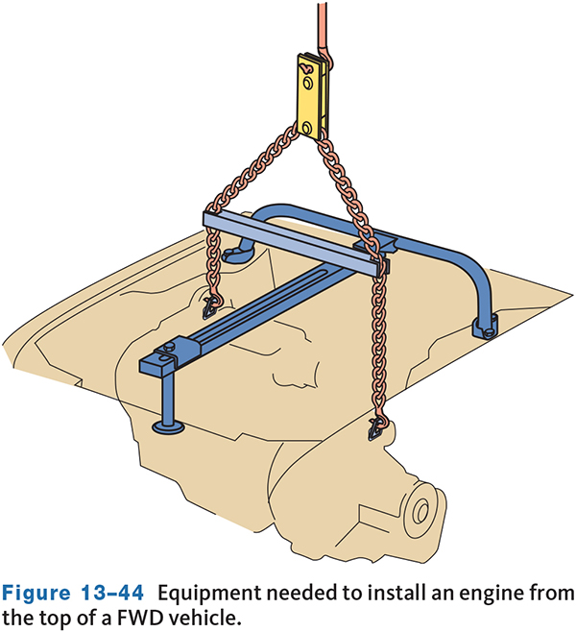
Installing the Engine (1 of 7)
13.08 Reinstall an engine and perform the correct starting and break-in procedures.
Installing a computer-controlled engine can be a complex task requiring special procedures. Referring to the vehicle’s service information is essential for this procedure.
Installing an Engine into a FWD Vehicle: If the engine will be installed through the top, connect the engine to a sling and then connect the sling to the crane.
Slowly lower the engine into the engine compartment. Guide the engine around all wires and hoses to make sure nothing gets damaged.
As the engine approaches its position in the engine compartment, align the engine and transmission mounts. Then, lower the engine so you can connect the engine and transmission mounts.

Slide 35
Installing the Engine (2 of 7)
If the engine must be installed from under the car, mount the engine onto the engine cradle and dolly.
Lift the vehicle on a hoist and position the engine under the engine compartment. Carefully lower the vehicle until the engine and transmission are properly positioned in the compartment.
While doing this, guide all wires and hoses out of the way and make sure that the vehicle does not contact or rest on any part of the engine or transmission.
With an engine hoist, raise the engine/transmission into place. Align the engine and transmission mounts and tighten the bolts.
While working under the vehicle, align and tighten all remaining engine/transmission mounts. Install the drive axle shafts and hubs.
Connect the exhaust manifold to the exhaust system. Install any heat shields that were removed when the engine was removed.
Connect all linkages, lines, hoses, and electrical wiring to the transmission.
Now reconnect all suspension and steering parts that were disconnected or removed.

Slide 36
Installing the Engine (3 of 7)
When installing an engine in a RWD vehicle, connect the engine to a sling and then connect the sling to the crane.
Place a transmission jack under the transmission to hold it in position.
Now slowly lower the engine into the engine compartment.
Guide the engine around all wires and hoses to make sure nothing gets damaged. As the engine approaches its position in the engine compartment, align the engine to the input shaft of the transmission or the torque converter hub into the front pump.
Carefully wiggle the engine until the input shaft slides through clutch disc splines or the torque converter seats into the transmission. Install the transmission to the engine bolts.
Start the engine mount bolts into their bores; you may need to wiggle the engine some to do this. Once the mount bolts are in place, tighten them and remove the transmission jack and engine sling.
Connect any remaining disconnected lines and hoses, making sure all connections are secure.
Fill the radiator with coolant and oil then check for leaks.

Slide 37
Installing the Engine (4 of 7)
Not prelubing a new or rebuilt engine before starting it can cause premature bearing failure due to poor lubrication.
Other parts such as pistons, rings, and cylinder walls need immediate lubrication to prevent scuffing, scoring, and damage.
It can take as long as 5 minutes after the engine has started before oil is distributed through all of the vital parts of an engine.
It is claimed that more than 80 percent of all engine wear occurs when an engine is first started. These problems can be prevented by lubricating the parts as they are assembled and by forcing oil into the oil galleries. This is the purpose of prelubing.
A prelubricator forces oil throughout the engine before it is started. There are several ways to prelubricate, or prime, an engine. One of the most common ways is to use an air-operated prelubricator.
Distributor-Driven Oil Pumps: On engines with a distributor-driven oil pump, the engine can be primed by driving the oil pump with an electric drill.

Slide 38
Installing the Engine (5 of 7)
Starting Procedure
  On engines with an ignition distributor, set the ignition timing as accurately as possible before starting the engine.
  The timing can be properly set after it has been started by using an engine analyzer or timing light.
  Fill the gasoline tank with several gallons of fresh gasoline.
  Start the engine and run it at around 1,500 rpm.
  When the engine coolant reaches normal operating temperature, turn off the engine.
  Recheck all adjustments, ignition timing, and valve clearance.
  Look for signs of coolant or oil leaks.

Slide 39
Installing the Engine (6 of 7)
Break-In Procedure:
To prevent engine damage after it has been rebuilt and to ensure good initial oil control and long engine life, the proper break-in procedure must be followed.
Make a test run at 30 mph and accelerate at full throttle to 50 mph.
Repeat the acceleration cycle from 30 to 50 mph at least 10 times. No further break-in is necessary. If traffic conditions will not permit this procedure, accelerate the engine rapidly several times through the intermediate gears during the road test.
The objective is to apply a load to the engine for short periods and in rapid succession soon after the engine warms up.
This action thrusts the piston rings against the cylinder wall with increased pressure and results in accelerated ring seating.

Slide 40
Installing the Engine (7 of 7)
Relearn Procedures:
The computer in most late-model vehicles must undergo a relearn or initialization procedure after the battery has been reconnected. This procedure allows the computers to learn the condition of the engine and make adjustments according to the engine’s restored condition.
The last time the engine was run, the computer made adjustments based on the engine faults present.
This procedure allows the computer to see that those faults were corrected. Initialization also resets the reference for the crankshaft position sensor and PCM.
Always follow the manufacturer’s procedures as outlined in the service information.

Slide 41
Knowledge Check (2 of 2)
What is the reason for prelubing a newly rebuilt engine before start up?

Slide 42
Knowledge Check Answer (2 of 2)
Not prelubing a new or rebuilt engine before starting it can cause premature bearing failure due to poor lubrication.
Other parts such as pistons, rings, and cylinder walls need immediate lubrication to prevent scuffing, scoring, and damage.
It can take as long as 5 minutes after the engine has started before oil is distributed through all of the vital parts of an engine.
It is claimed that more than 80 percent of all engine wear occurs when an engine is first started.

Slide 43
Chapter Reflection
Please take a moment to compare your perception of the automotive industry before and after you studied this chapter. Then respond to the following questions in one or two paragraphs. Use 150–200 words in your reflection.
Did anything in this chapter change your thinking about engine sealing and reassembly?
Considering all you have learned, do you feel you prepared to perform final assembly and start up on an engine? What can you do to be as prepared as possible?

